Slide 1
LOADING AND WORKING WITH TEXTURES
Dandy Naufaldi 05111640000011
Nuzha Musyafira 05111640000014
Rahandi Noor P. 05111640000054
Ghifaroza R. 05111640000057

Slide 2
Basic Usage of Textures
How textures define color, wrinkles, bumps, and reflections.

Slide 3
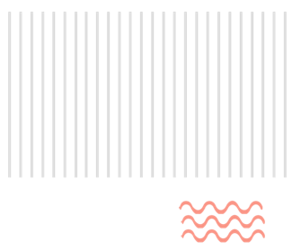
LOADING AND APPLYING A TEXTURE
THREE.ImageUtils.loadTexture
Used to load an image file (PNG, GIF, or JPEG) from a specific location as input for a texture.
To load textures in different formats we can use other loaders below :
THREE.DDSLoader : to load textures in the DirectDraw Surface format.
THREE.PVRLoader : to load textures in the Power VR format.
THREE.TGALoader : to load textures in the Targa format.

Slide 4
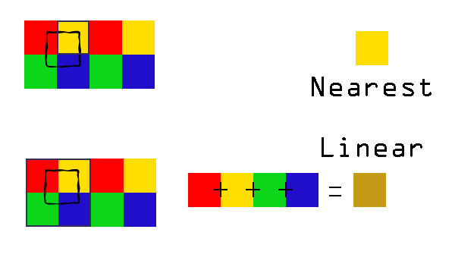
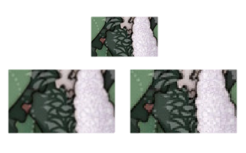

LOADING AND APPLYING A TEXTURE
Since the texels (texture pixels) usually don’t map one-to-one on the face pixels, the texture needs to be magnified or minified.
THREE.NearestFilter
Uses the color of the nearest texel that can be found.
Magnification → blocky
Minification → lose much detail
THREE.LinearFilter
Uses the color value of the 4 neighbouring texels.
Magnification → smoother and less blocky
Minification → lose much detail

Slide 5
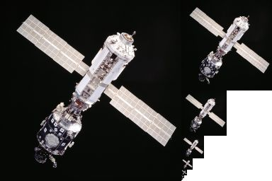
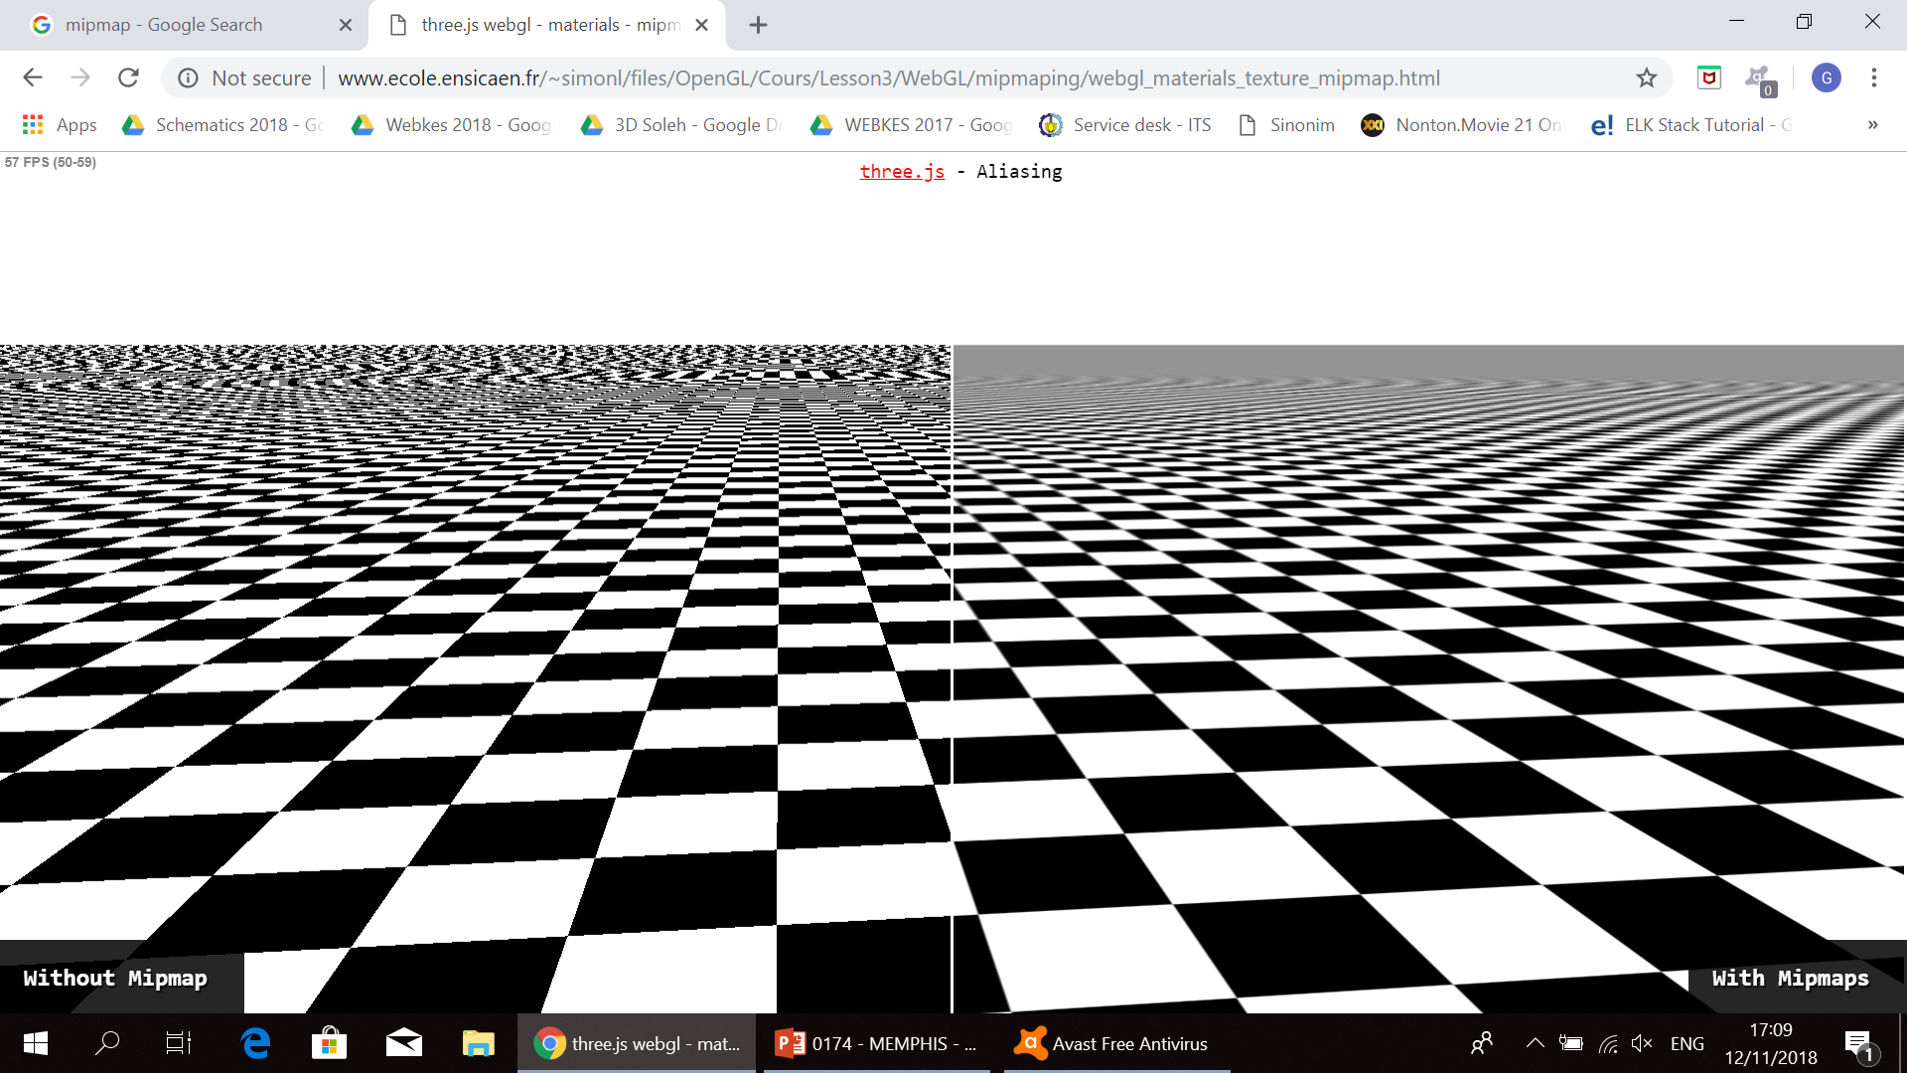
LOADING AND APPLYING A TEXTURE
We can also use a mipmap, that is a set of texture images, each half the size of the previous one. Using mipmaps helps to avoid moiré patterns.
THREE.NearestMipMapNearestFilter
THREE.NearestMipMapLinearFilter
THREE.LinearMipMapNearestFilter
THREE.LinearMipMapLinearFilter
Without mipmap
With mipmap

Slide 6
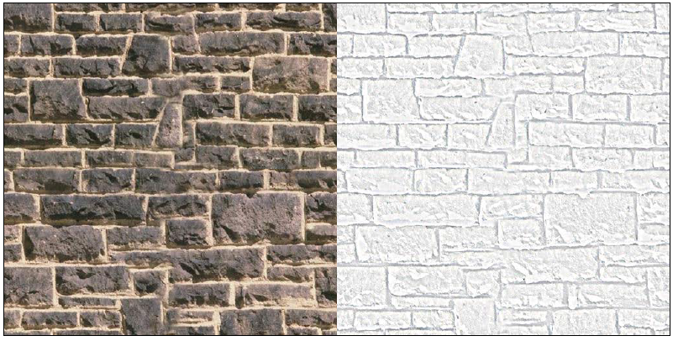
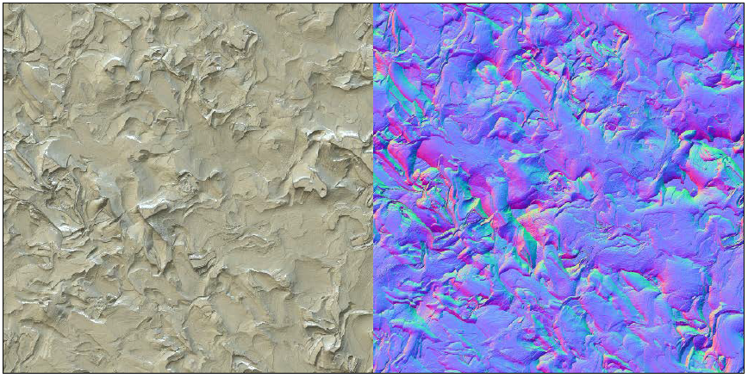
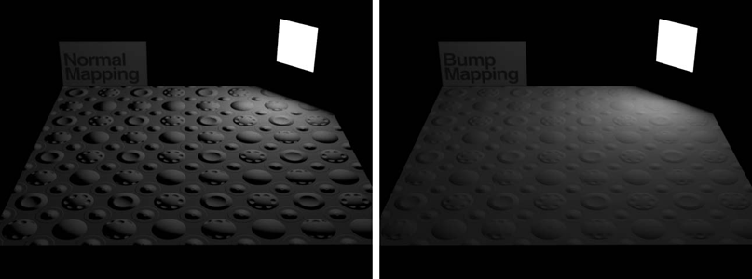
BUMP MAP
NORMAL MAP
Used to add more depth to a material.
The level of detail and perception of depth that can be reach is limited in a bump map.
Used to create very detailed-looking models.
Normal maps aren’t very easy to create.
Bump mapping
Normal mapping

Slide 7
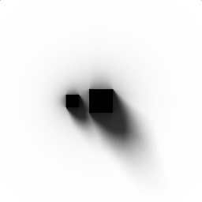
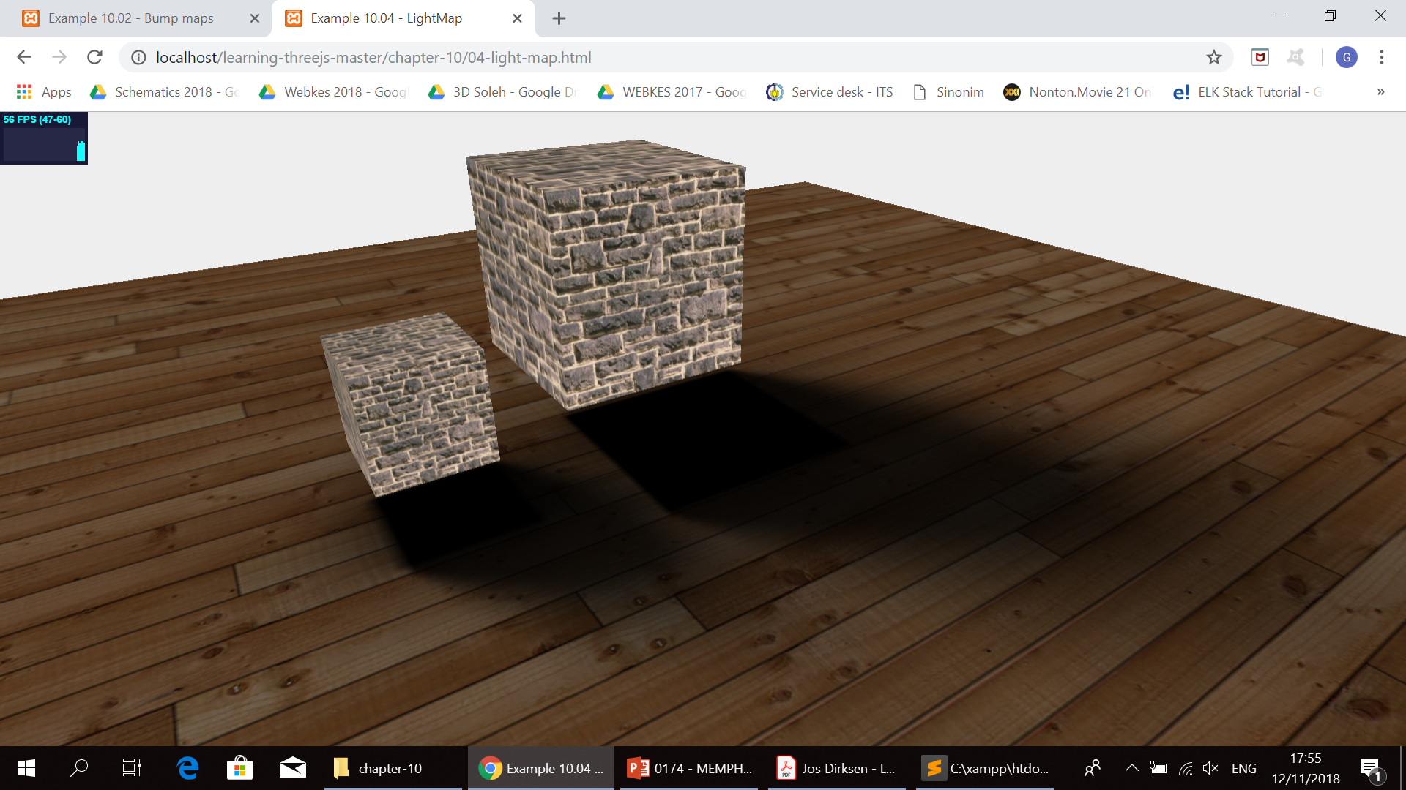
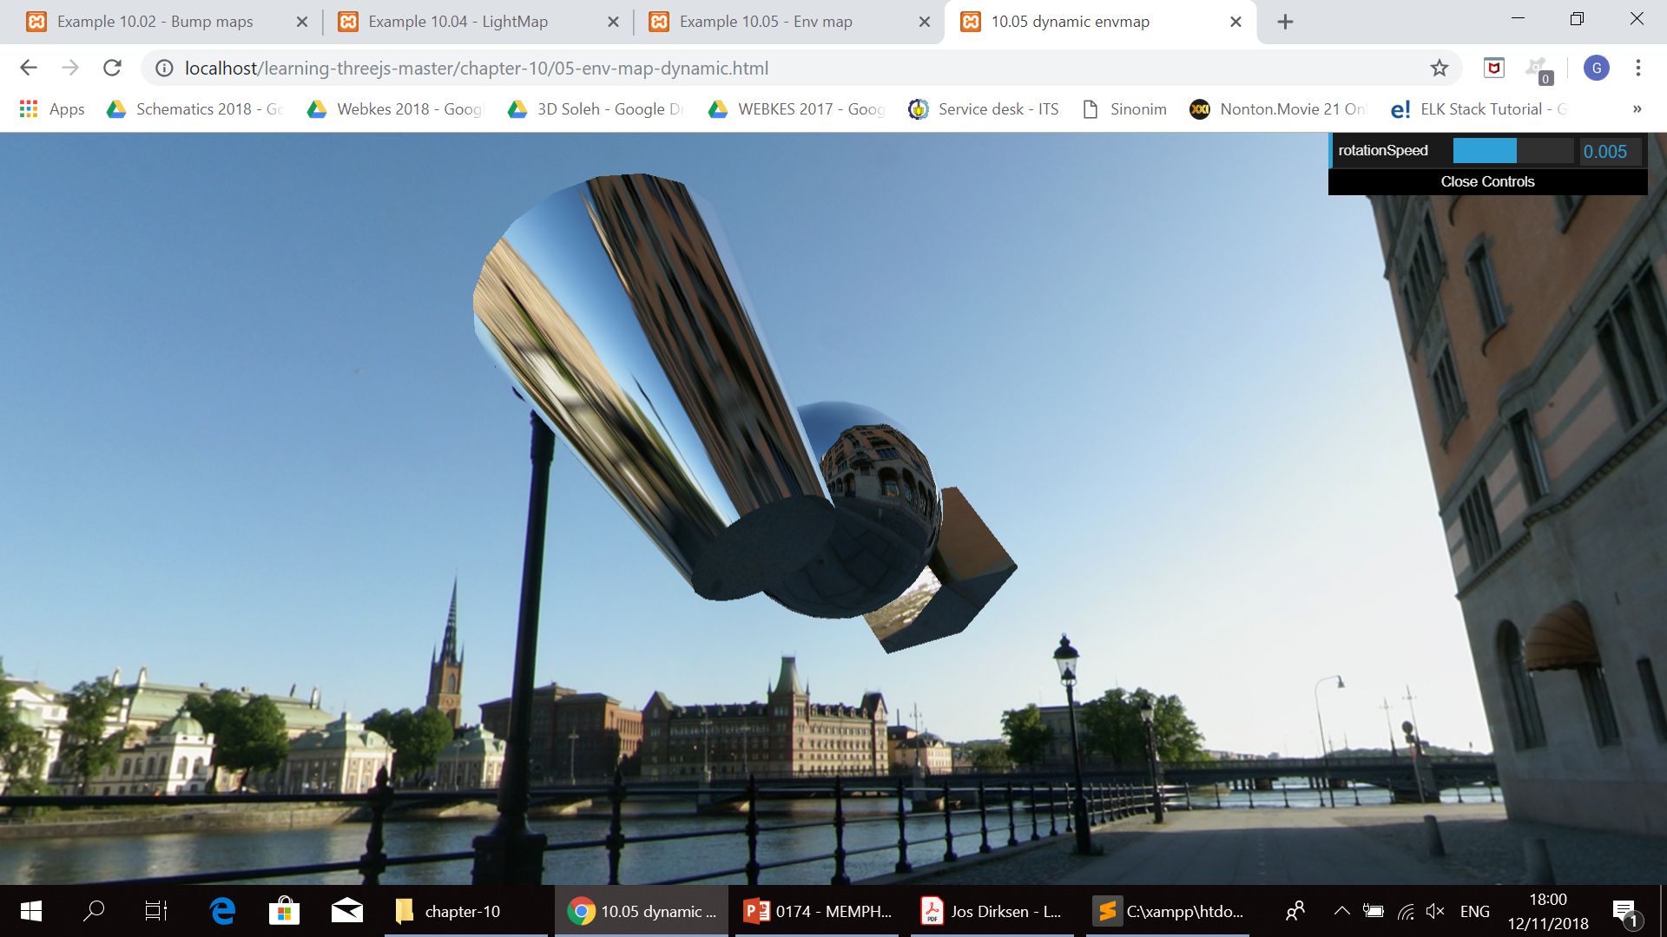
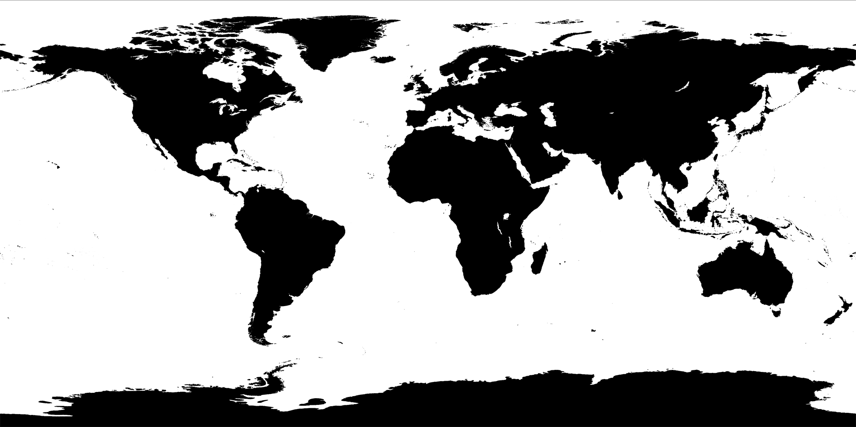
LIGHT MAP
ENVIRONMENT MAP
Used to create fake shadows.
Used to create fake reflections.
SPECULAR MAP
Used to defines shininess and the highlight color of a material. The higher the value of the pixel, the shinier the surface will appear.

Slide 8
Advanced Usage of Textures
Custom UV mapping, repeat wrapping, using canvas as a bump map, and using the output from a video as a texture.

Slide 9
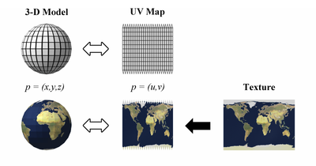
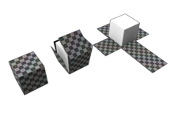
CUSTOM UV MAPPING
REPEAT WRAPPING
WrapS property
Defines how the texture behaves along its x axis.
WrapT property
Defines how the texture behaves along its y axis.
THREE.RepeatWrapping
Used to set the property that controls how a texture repeats itself.
THREE.ClampToEdgeWrapping
The texture doesn’t repeat as a whole, but only the pixels at the edge are repeated.
Used to specify what part of a texture is shown on a specific face.

Slide 10
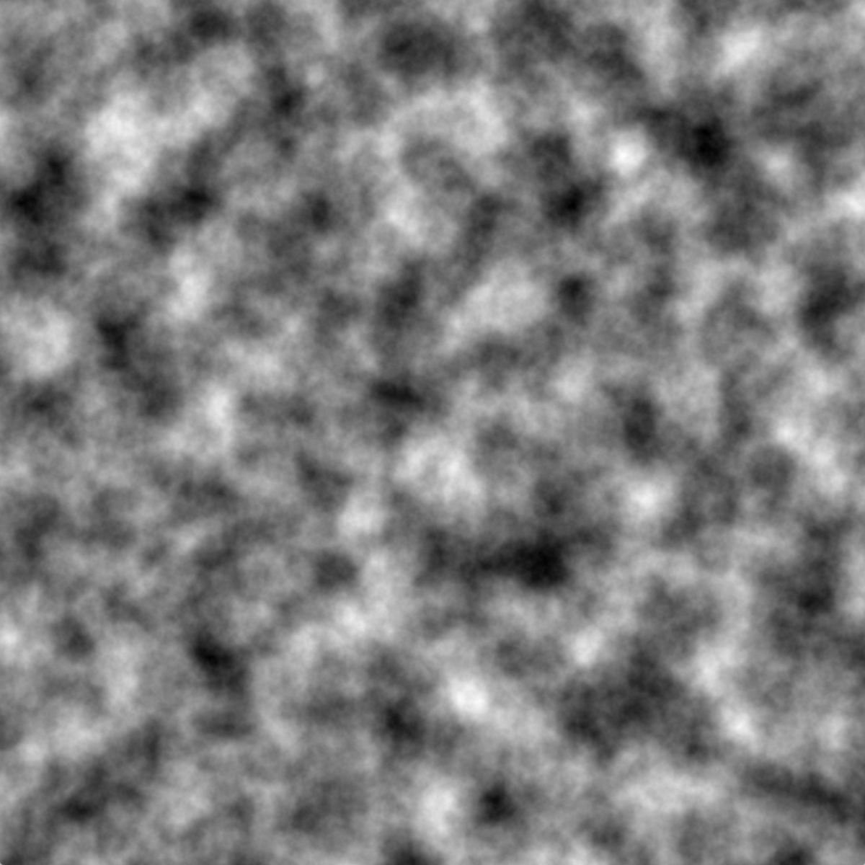
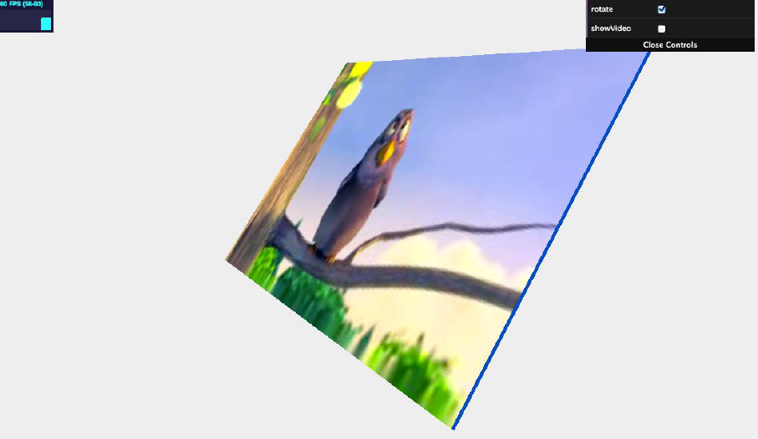
USING CANVAS AS A BUMP MAP
Create a canvas element
Fill the canvas with some random noise (we will use Perlin noise)
USING THE OUTPUT FROM A VIDEO AS A TEXTURE

Slide 11
THANK YOU

